Slide 1
«include» and «extend» Relationships in
Use Case Models

Slide 2
SCENARIO
Description of a Use Case
Steps are usually arranged into a Basic Flow and Alternative Flows.
The Basic Flow has other names, such as the Main Success Scenario or Happy Day scenario
    It describes the steps that are required for a straightforward (but not always the simplest) execution of the Use Case.
    The Alternative Flows are also known by other names, such as exceptions or extensions
    Each one describes some variation from the steps in the Basic Flow The Use Case steps, both in the Basic and Alternative Flows, are usually numbered. This

Slide 3
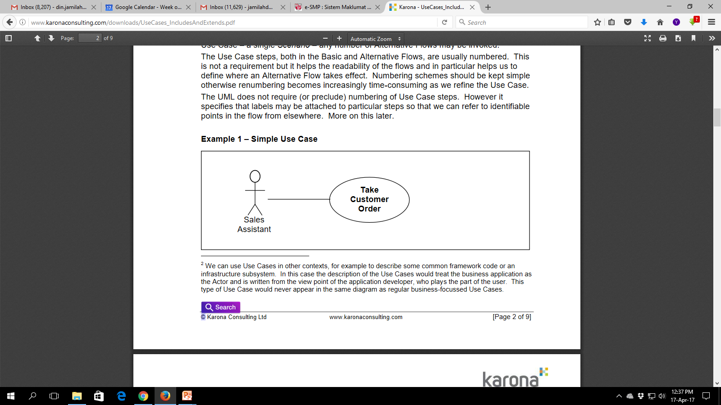
Simple Use Case
Use Case: “Take Customer Order”
Basic Flow:
1. SA enters Customer details
2. SA enters code for product required
3. System displays Product details
4. SA enters quantity required
5. SA enters Payment details
6. System saves Customer Order
Alternative Flows:
[multiple products]
After step 4, when the SA enters the quantity required, Repeat steps 2 to 4 for additional Products. Resume at step 5, to enter Payment details

Slide 4
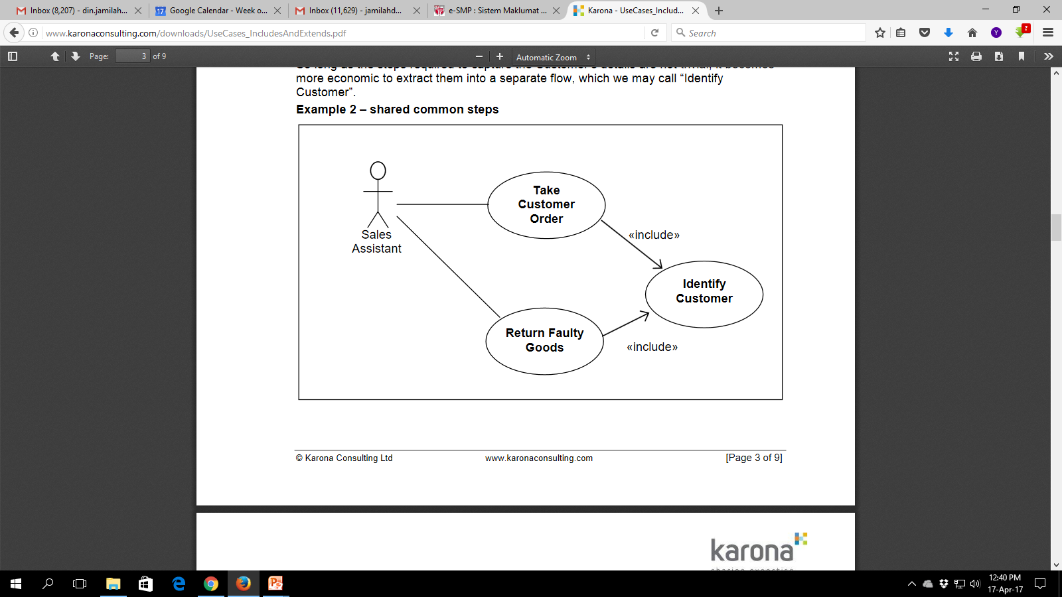
«include» relationship

Slide 5
«include» relationship

Slide 6
Use Case: “Identify Customer”
Basic Flow:
1. SA enters search criteria, surname and postcode
2. System displays matching Customers
3. SA selects Customer
4. System displays Customer details
5. SA confirms Customer
Alternative Flows:
[new customer]
After step 2, when the System does not display the required Customer, SA creates new Customer,
1. SA selects to add new Customer
2. SA enters Customer details
Resume at step 5, to confirm Customer

Slide 7
Use Case: “Take Customer Order” - modified
Basic Flow:
1. SA records Customer details, include (Identify Customer)
2. SA enters code for Product required
3. System displays Product details
4. SA enters quantity required
5. SA enters Payment details
6. System saves Customer Order
Alternative Flows:
[multiple products]
After step 4, when the SA enters the quantity required, Repeat steps 2 to 4 for additional Products Resume at step 5, to enter Payment details

Slide 8
«extend» relationship
Suppose we want to sell products that are made to order and require a degree of customer specification. For these products we will need to record the customer’s additional requirements, such as size and colour. In this case we are adding something extra to the flow of the base Use Case.
We could do this as an Alternative Flow, as in the example.
The «extend» relationship says that we execute the base Use Case but when we get to a specified point in the flow, if the right conditions are met, we perform some different steps.
Clearly this is very similar to an Alternative Flow.

Slide 9
Use Case: “Take Customer Order”
Basic Flow:
1. SA records Customer details include(Identify Customer)
2. SA enters code for product required
3. System displays product details
4. SA enters quantity required
5. SA enters payment details
6. System saves Customer Order
Alternative Flows:
[multiple products]
After step 4, when the SA enters the quantity required, Repeat steps 2 to 4 for additional products Resume at step 5, to enter payment details [customer specified product] At step 3, when the System displays the Product details, if the product requires customer specified features, SA enters customer specified requirements, such as size and colour Resume at step 4, to enter quantity required, until step 6 where the Customer Order is saved.
At this step the additional customer - specific product details must also be saved.

Slide 10
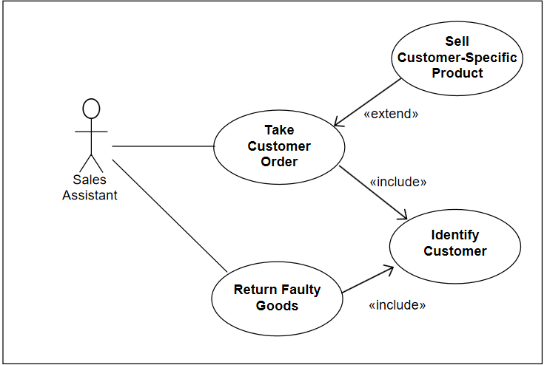

Slide 11
Use Case: “Sell Customer - Specific Product”
Basic Flow:
At step 3, when the System displays the Product details, if the product requires customer specified features,
1. SA enters customer specified requirements, such as size and colour Resume at step 4, to enter quantity required, until step 6 where the Customer Order is saved.
At this step the additional customer - specific product details must also be saved.

Slide 12
generalisation relationship
A generalisation relationship between Use Cases indicates that the child Use Cases inherit the properties of the parent Use Case.
Examples where this is a valuable aid to creating a useful Use Case model seem to be hard to find. We suspect that the generalisation relationship arises more from a theoretical consideration than any practical need.
The following example is provided only for completeness.

Slide 13
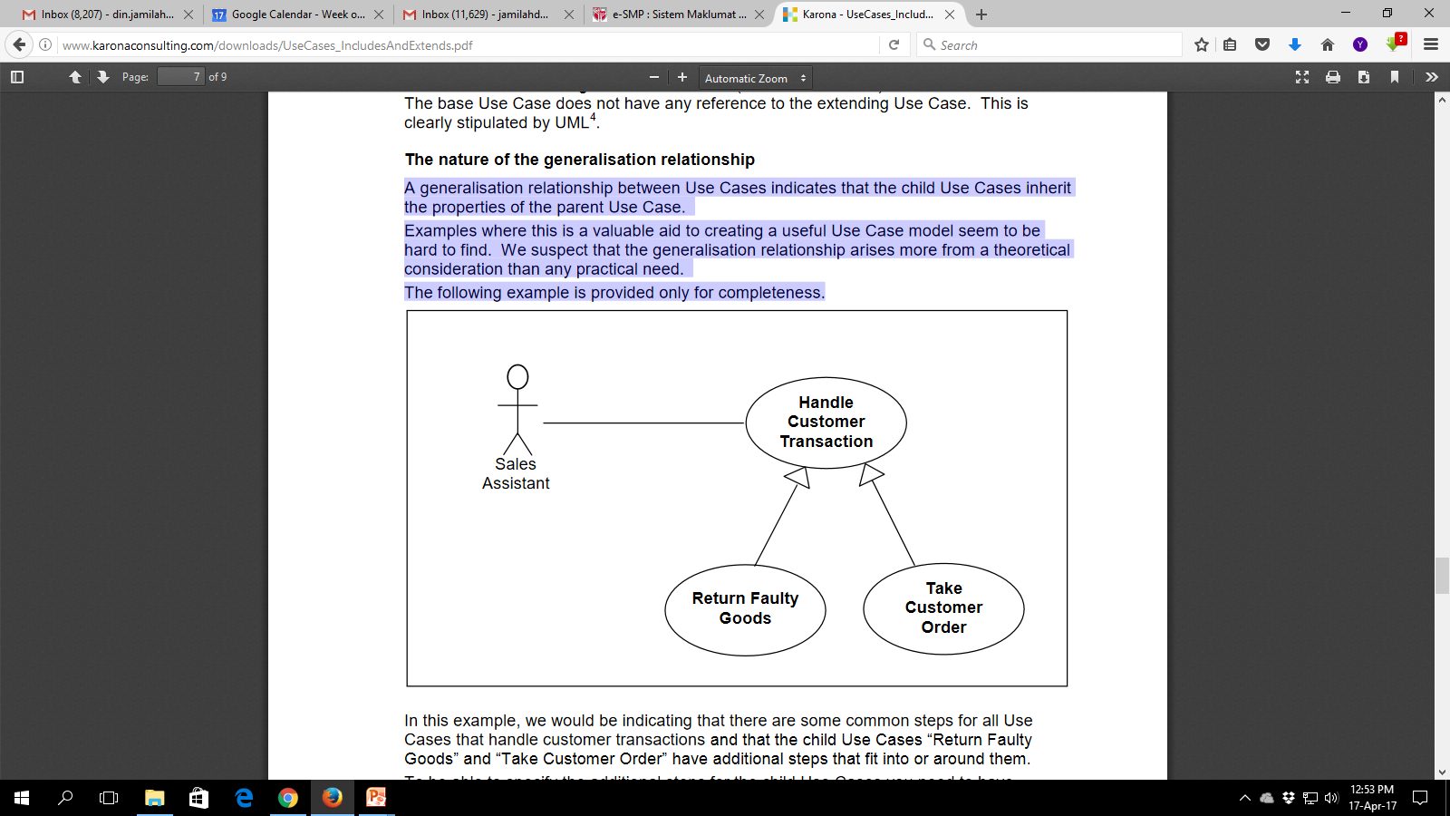
Indicating that there are some common steps for all Use
Cases that handle customer transactions
and that the child Use Cases “Return Faulty
Goods” and “Take Customer Order” have additional steps that fit into or around them.

Slide 14
When to use «include» relationship
After you have completed the first cut description of all your main Use Cases. You can now look at the Use Cases and identify common sequences of user-system interaction.
After have completed the first cut description of all your main Use Cases. In fact you should be able to produce a pretty complete first cut Use Case Model without any «extend» relationships and we would advise you to do this. The extending Use Cases represent additional functionality, without which the model is consistent in itself

Slide 15
When to use «extend» relationship
The «extend» relationship should be applied to a well - formed first cut Use Case model in the following circumstances:
1. A Use Case is too big. If a use Case description, with all its alternative flows is becoming unmanageable, use this as a strategy to break it up. Take a substantial alternative path, that is reasonably self - contained and make it an extending Use Case.
2. The base Use Case is something that for one reason or another we don’t want to change. It may be that the base Use Case is part of an existing system implementation and perhaps there is no existing Use Case model for that system but we want to create a Use Case description for the new functionality. Using an «extend» relationship helps us to separate out our specification of the new functionality from the old.

